Slide 1
Voxel-based modeler 進度報告
Data structure
GUI

Slide 2
outline
Introduction
Data Structure
Object Tree
Enqueueable Linked List
GUI
Discussion
Future work
Conclusion

Slide 3
Introduction
以一個場景為模型的基礎，新增刪除Voxel Data並且以樹狀結構表示它們之間的關係
設計資料結構以實作其功能

Slide 4
Data Structure
typedef structure VoxelModel{
char name[512];
int resolution[3];
float voxelsize[3];
int num_voxeldata;
vobj_t * root_obj;
ditem_t * rootitem;
}vmodel_t;
typedef structure VoxelObject{
char name[512];
aabb_t* bbox;
int number_of_child;
vobj_t* parent;
vobj_t* nextSibling;
vobj_t* prevSibling;
vobj_t* firstChild;
ditem_t * dataitem;
}vobj_t;

Slide 5
Data Structure(cont.)
typedef structure DataItem{
enqdlist_t list;
vdat_t* vd;
}ditem_t;
typedef structure VoxeData{
char name[512];
int resolution[3];
float voxelsize[3];
voxel_t* rawdata;
}vdat_t;

Slide 6
Object Tree
vmodel_t* vm
樹狀結構以DFS記錄在檔案內
vobj_t* rootobj
firstChild
parent
vobj_t* obj
vobj_t* obj
nextSibling
vobj_t* obj
vobj_t* obj
prevSibling
vobj_t* obj
vobj_t* obj
ditem_t * dataitem
ditem_t * dataitem
ditem_t * dataitem
ditem_t * dataitem

Slide 7
Object Tree(Cont.)
利用Object Tree找出所有Voxel Data加至Enqueueale Linked List
void findDataItem(vobj_t* vo){
if (vo->number_of_child == 1) {
addtoEnqlist(vo-> dataitem);
return;
}
else {
vobj* temp = vo->firstChild;
While(temp!=NULL){
findDataItem (temp);
temp = temp->nextSibing;
}
}
}

Slide 8
Enqueueable Linked List
vmodel_t* vm
flink
Enqitem list
NULL
Enqitem list
vdat* vd
Enqitem list
vdat* vd
Enqitem list
vdat* vd
blink

Slide 9
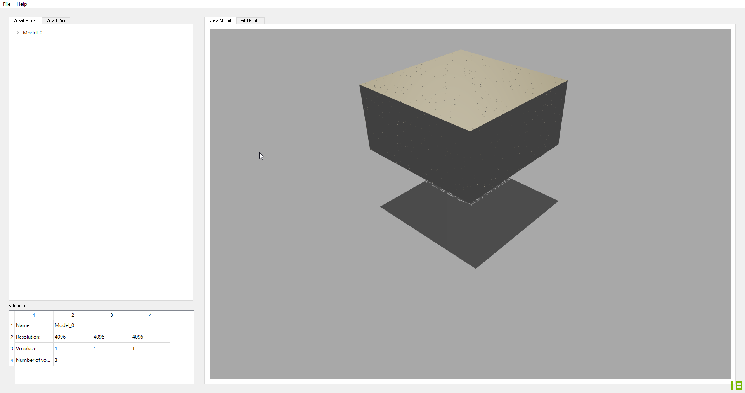
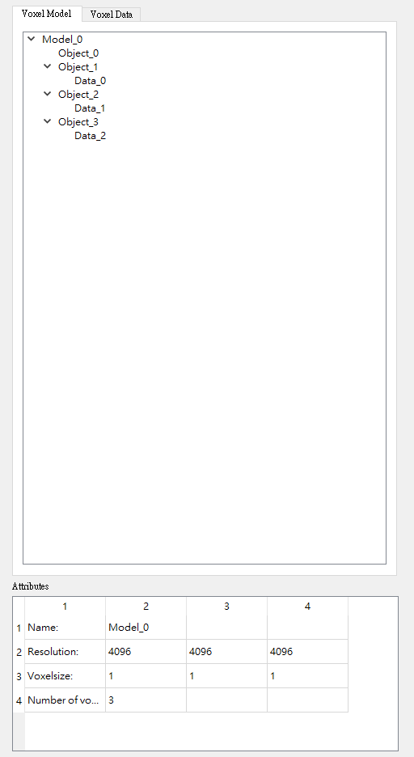
GUI
1
2 & 3
5 & 6
1.Open File & Export File
2.Object Tree View
3.Voxel Data List View
4.Attribute View
5.Voexl Model Window
6.Voxel Data Window
4

Slide 10
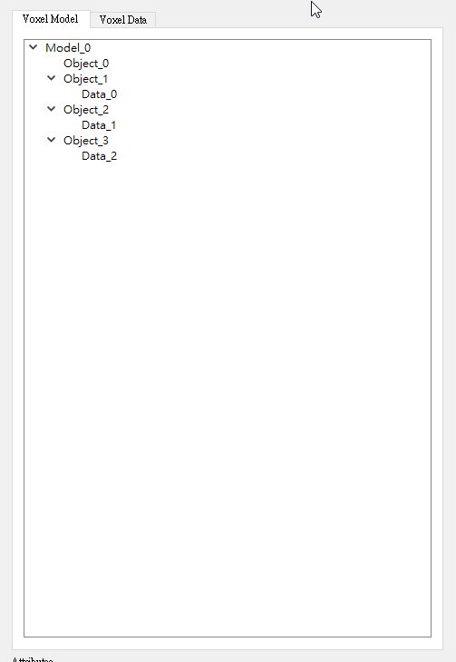
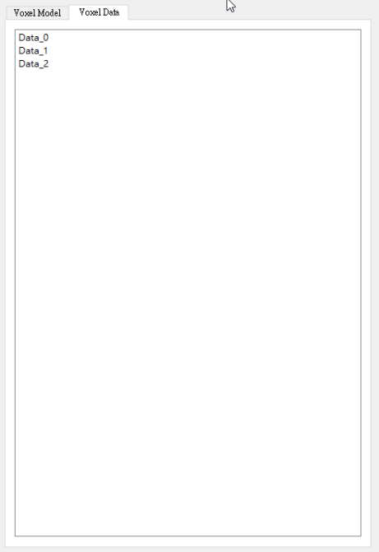
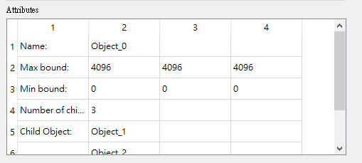
GUI(CONT.)
Model Tree
Data List
Model Tree View
在Model Window內標示出點選的物件
對點選的物件進行Translate、Rotate、Scale
變更子物件親子關係
Data List View
在Data Window Render並可以進行編輯
Attribute View
顯示點選的不同物件資訊
Attribute

Slide 11
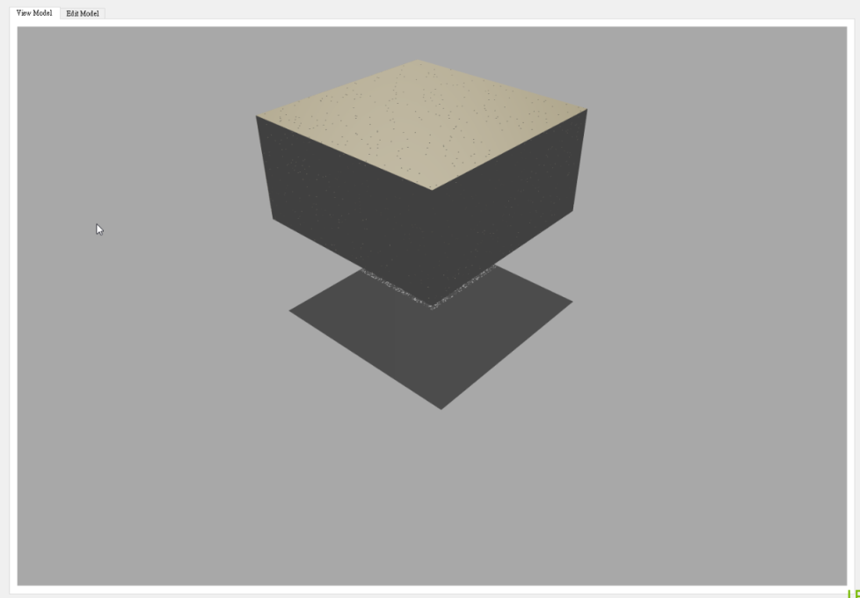
GUI(CONT.)
Model Window
在此視窗預覽整個模型的狀況
並對不同子物件進行Translate、Rotate、Scale

Slide 12
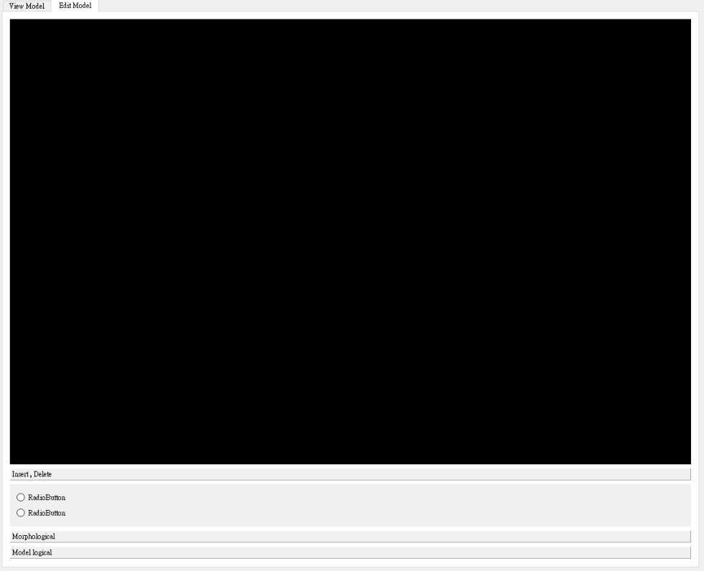
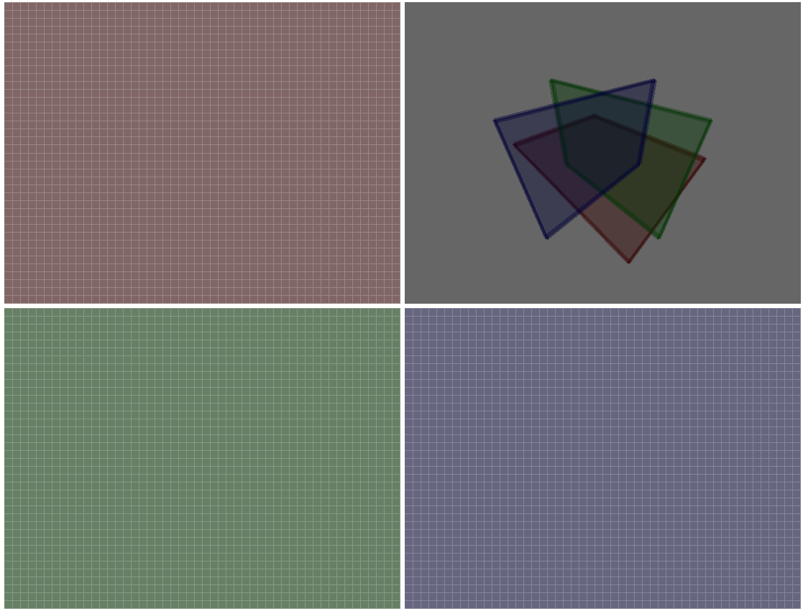
GUI(CONT.)
Edit Window
四視圖顯示每一層Voxel Data
功能選單
Insert & Delete
Morphological operation
Model Logical operation

Slide 13
Discussion
1.Voxel Data大小限制
2.Object與Object做CSG的困難度
3.Distance Field只能對個別Voxel Data進行運算
4.要輸出成Gcode時是否再對整個Model進行Voxelization

Slide 14
Future work
完善Edit Window
Object的選取與Translate、Rotate、Scale
將新增的Voxel Object加入Voxel Model內
對Voxel Model內的物件更改其結構

Slide 15
Conclusion
訂好Voxel Model的資料結構
設計GUI與操作方式
編輯Voxel Data的功能

Slide 16
Thanks for listening

